Slide 1




The GEMOC Studio
McGill University, June 8th, 2017
Benoit Combemale (Inria & Univ. Rennes 1)
http://people.irisa.fr/Benoit.Combemale
benoit.combemale@irisa.fr
@bcombemale

Slide 2
Tutorial website (~)
https://github.com/gemoc/ICSA2017Tutorial
See:
https://github.com/gemoc/ICSA2017Tutorial/blob/master/readme-mcgill.md
https://github.com/gemoc/ICSA2017Tutorial/blob/master/slides/tutorial-mcgill-slides.pptx

Slide 3
LANGUAGE ENGINEERING
Introduction and Context

Slide 4
What is a language?
“A system of signs, symbols, gestures, or rules used in communication”
The special vocabulary and usages of a scientific, professional, or other group”
“A system of symbols and rules used for communication with or between computers”
“The words, their pronunciation, and the methods of combining them used and understood by a community”

Slide 5
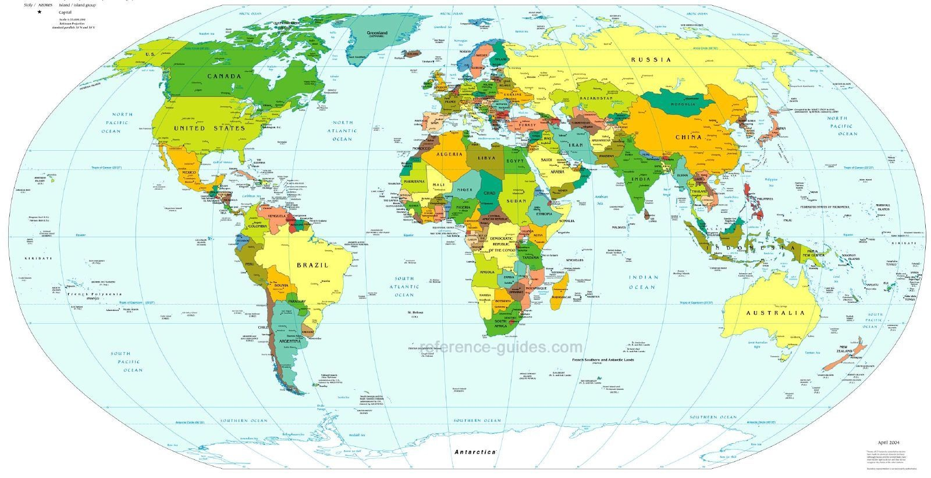
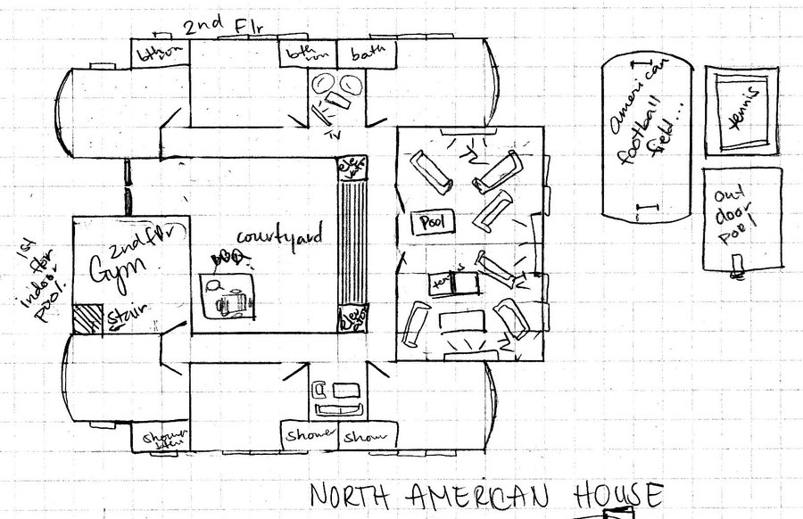
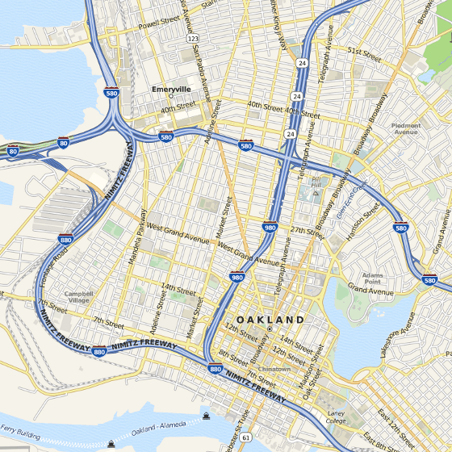
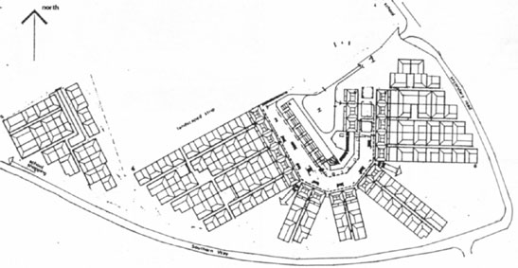
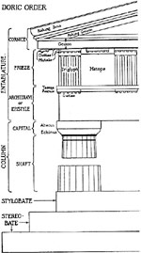
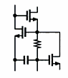
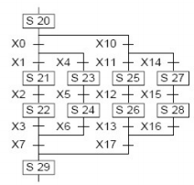
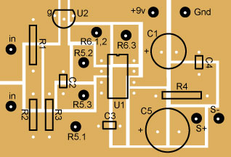
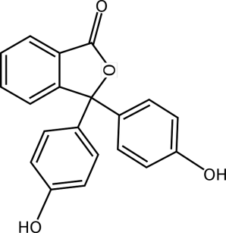
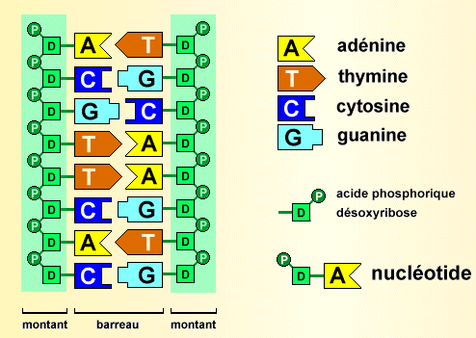
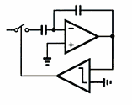
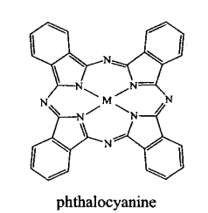
Languages in various domains
Cartography
Architecture
Electronics
Biology

Slide 6
Languages in software engineering
“Languages are the primary way in which system developers communicate, design and implement software systems”

Slide 7
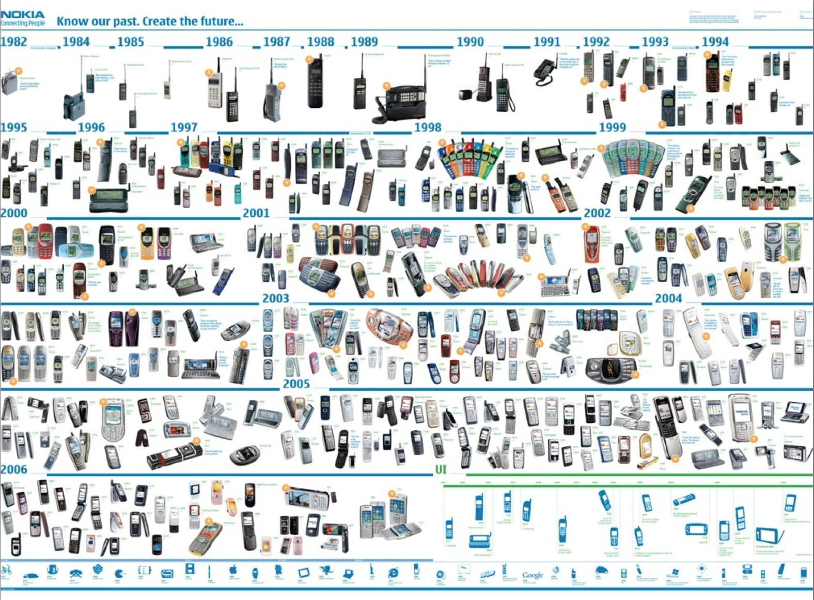





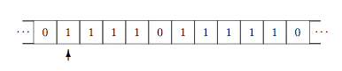
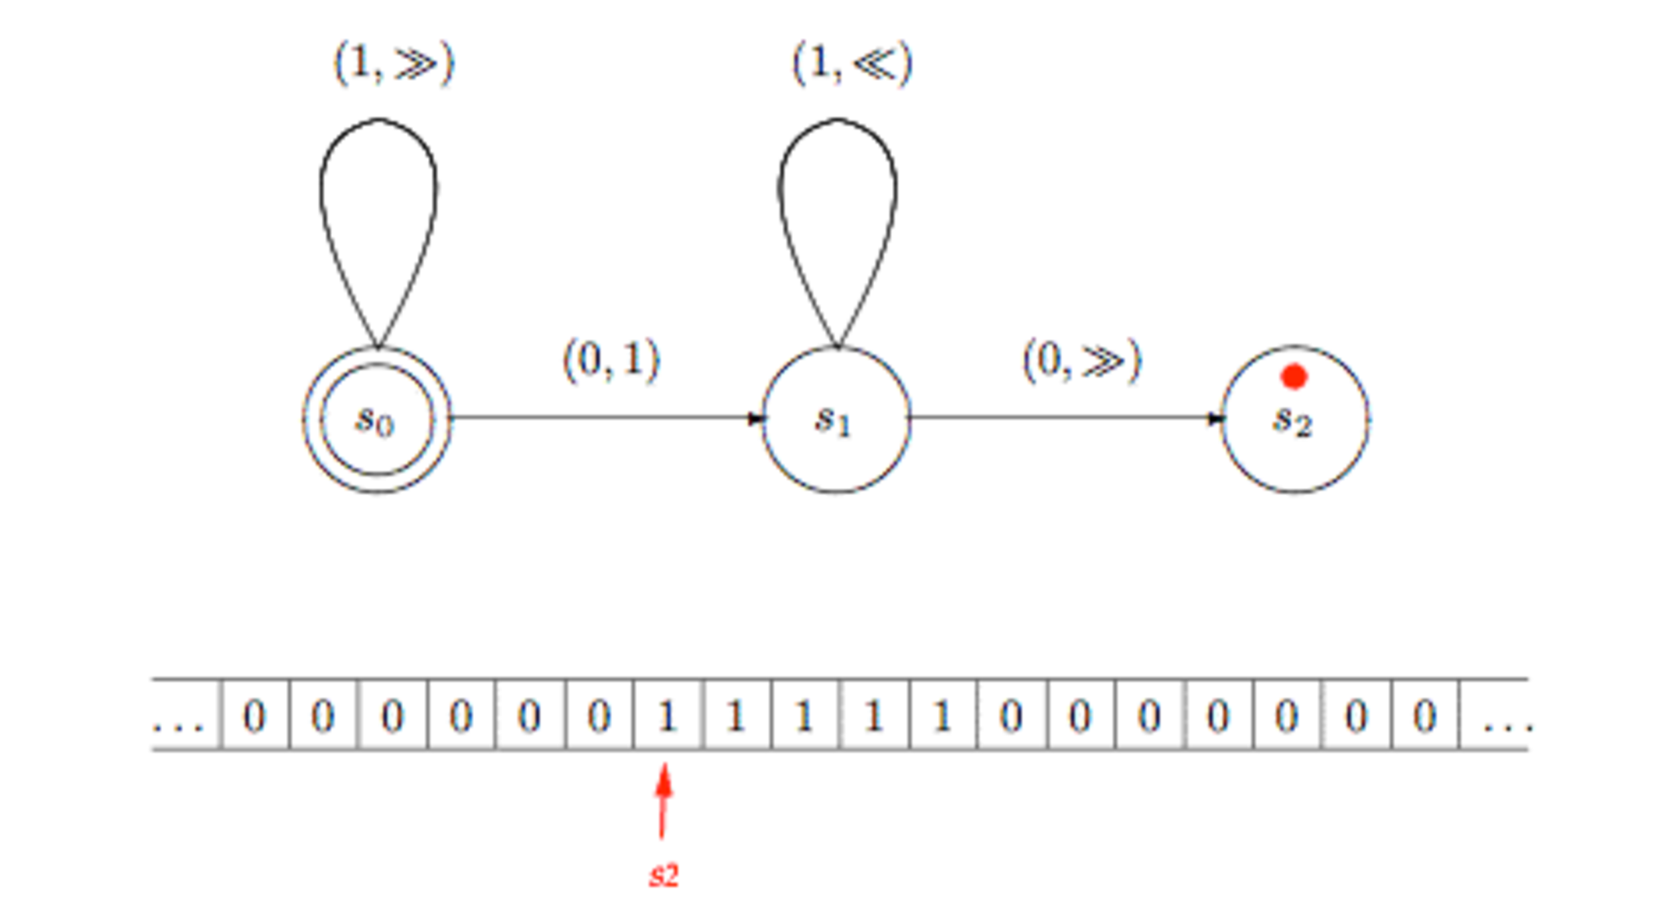
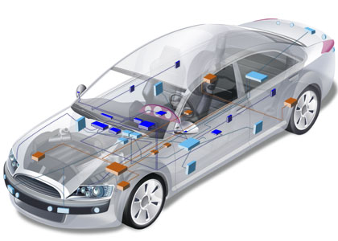

General purpose (programming) languages
Assembly COBOL Java LISP C++ PHP Scala C# Ruby Scheme Python…
7
Notes:
Turing

Slide 8
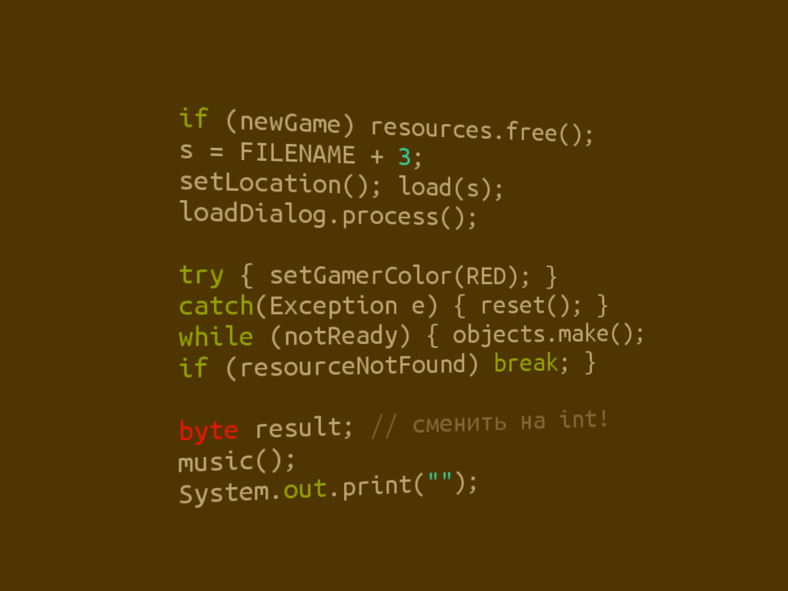



Limits of general purpose languages
Abstractions and notations are not natural/suitable for the stakeholders

Slide 9

Limits of general purpose languages
Not targeted to a particular kind of problem, but to any kind of software problems
Flexibility comes at a price
Conceptual gap
Accidental complexity
Maintenance, evolution
Not necessary for many problems

Slide 10
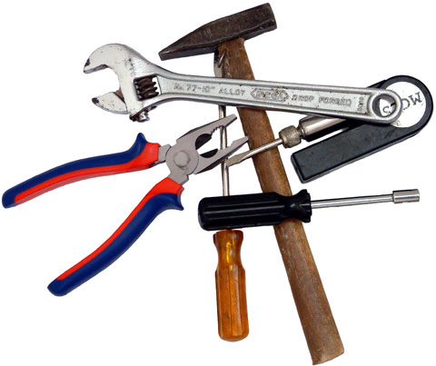
Domain-Specific Languages
Targeted to a particular kind of problem, with dedicated notations (textual or graphical), support (editor, checkers, etc.)
Promises: more efficient languages for resolving a set of specific problems in a domain
Long history: as long as computing
You use DSLs on daily basis
Examples to come

Slide 11
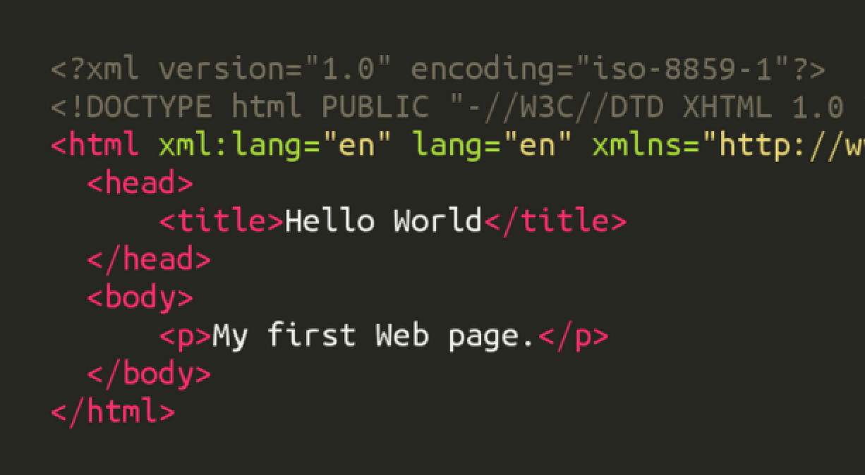
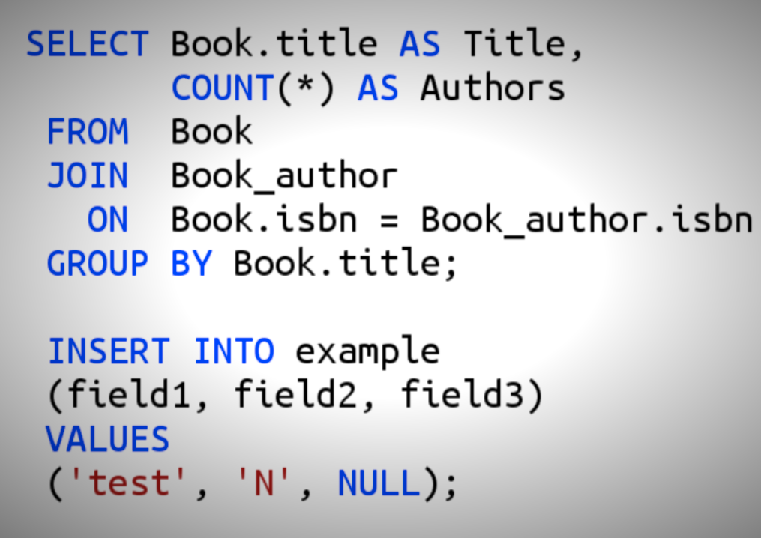
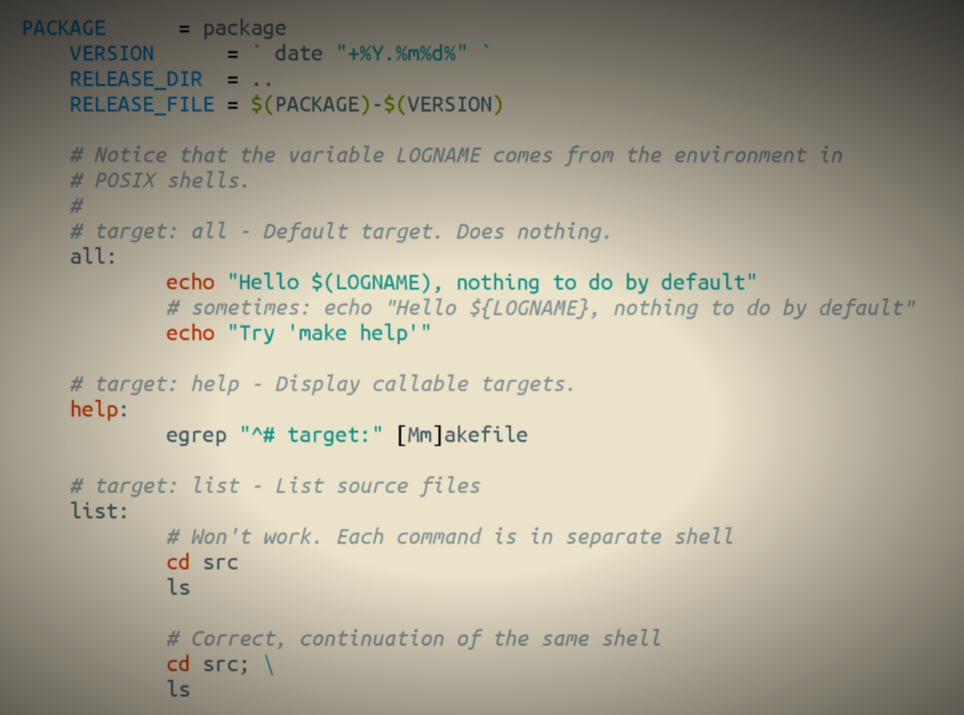
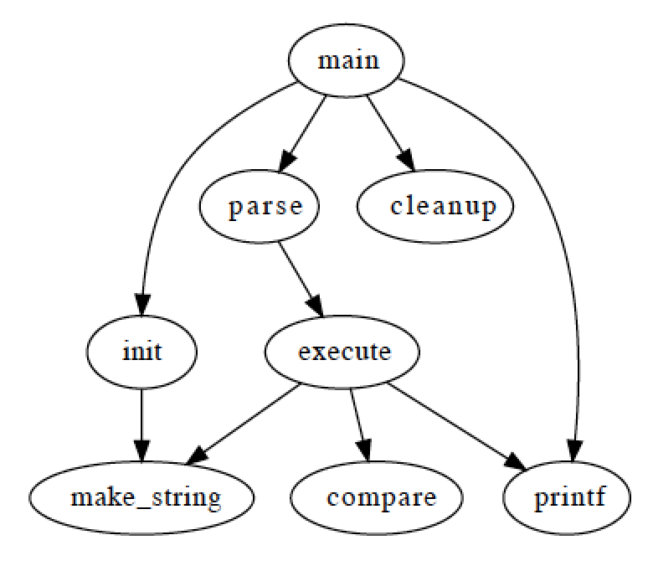
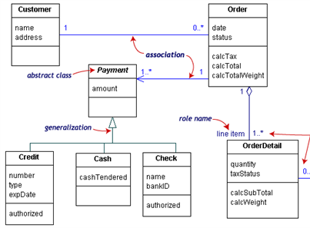
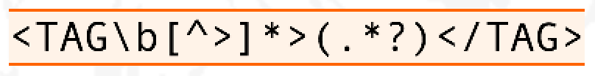
Examples of DSLs
HTML
SQL
Makefile
Graphviz
Regular Expressions
UML

Slide 12
"Software languages are software too"
J-M. Favre, D. Gasevic, R. Lämmel, and E. Pek. "Empirical language analysis in software linguistics," In Software Language Engineering, volume 6563 of LNCS, pages 316–326. Springer, 2011.
Towards Language-Oriented Modeling – B. Combemale (Univ. Rennes 1) – May 3rd, 2017

Slide 13
Model-driven engineering (MDE)
Language Engineering
Modeling
Engineering Modeling Languages: Turning Domain Knowledge into Tools, by Benoit Combemale, Robert B. France, Jean-Marc Jézéquel, Bernhard Rumpe, Jim R.H. Steel, and Didier Vojtisek. Chapman and Hall/CRC, pp.398, 2016. Companion website: http://mdebook.irisa.fr

Slide 14
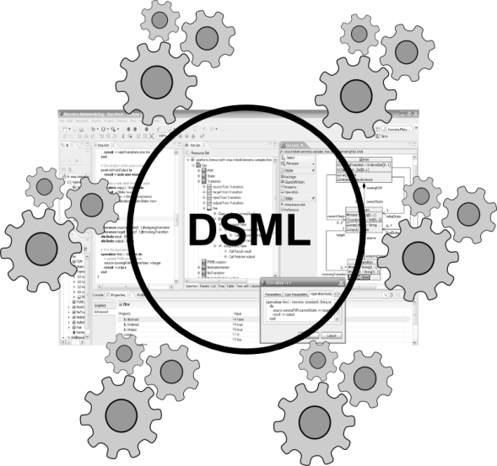
Language Design and Implementation
Editors
(textual, graphical, …)
Checkers
(static & dynamics)
Compilers
Test generators
Translators
Simulators
Code generators
Analyzers
Refactoring
etc.
Engineering Modeling Languages: Turning Domain Knowledge into Tools, by Benoit Combemale, Robert B. France, Jean-Marc Jézéquel, Bernhard Rumpe, Jim R.H. Steel, and Didier Vojtisek. Chapman and Hall/CRC, pp.398, 2016. Companion website: http://mdebook.irisa.fr

Slide 15
Software Language Engineering (SLE)
Application of systematic, disciplined, and measurable approaches to the development, deployment, use, and maintenance of software languages
Various shapes and ways to implement software languages
External, internal or embedded DSLs, Profile, etc.
Grammar, metamodel, ontology, etc.
Supported by various kind of "language workbench"
Eclipse EMF, Xtext, Sirius, GEMOC Studio, Papyrus
Jetbrain’s MPS
Spoofax, Monticore, Melange, Kermeta
MS DSL Tools
Etc.
More and more literature, a dedicated Intl. conference (ACM SLE, cf. http://www.sleconf.org)…
Towards Language-Oriented Modeling – B. Combemale (Univ. Rennes 1) – May 3rd, 2017

Slide 16
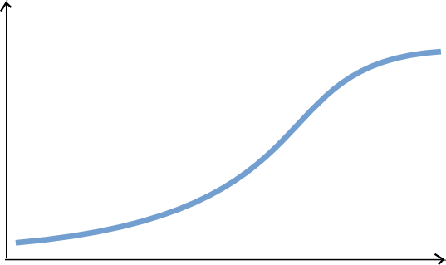
State of the art
Complete environment
Large scale deployment and distribution
Rich modeling tooling
(graphical, textual, forms)
Live Collaboration (cf. Google docs)
Customizations
Large models
Parametric code generators
Documentation generators
Analysis tools
Mission critical : tested and validated!
Easy automation
Basic editing features
Reflective and dynamic editors
Classic collaboration
EMF compare
Code generation!
Environment Completeness
Lot of work
Ease of Automation
Some hours
Features
Notes:
Learning curve very flat in the beginning

Slide 17
"A clear challenge, then, is how to integrate multiple DSLs."
J. Whittle, J. Hutchinson, and M. Rouncefield, “The State of Practice in Model-Driven Engineering,” IEEE Software, vol. 31, no. 3, 2014, pp. 79–85.

Slide 18
GEMOC

Slide 19


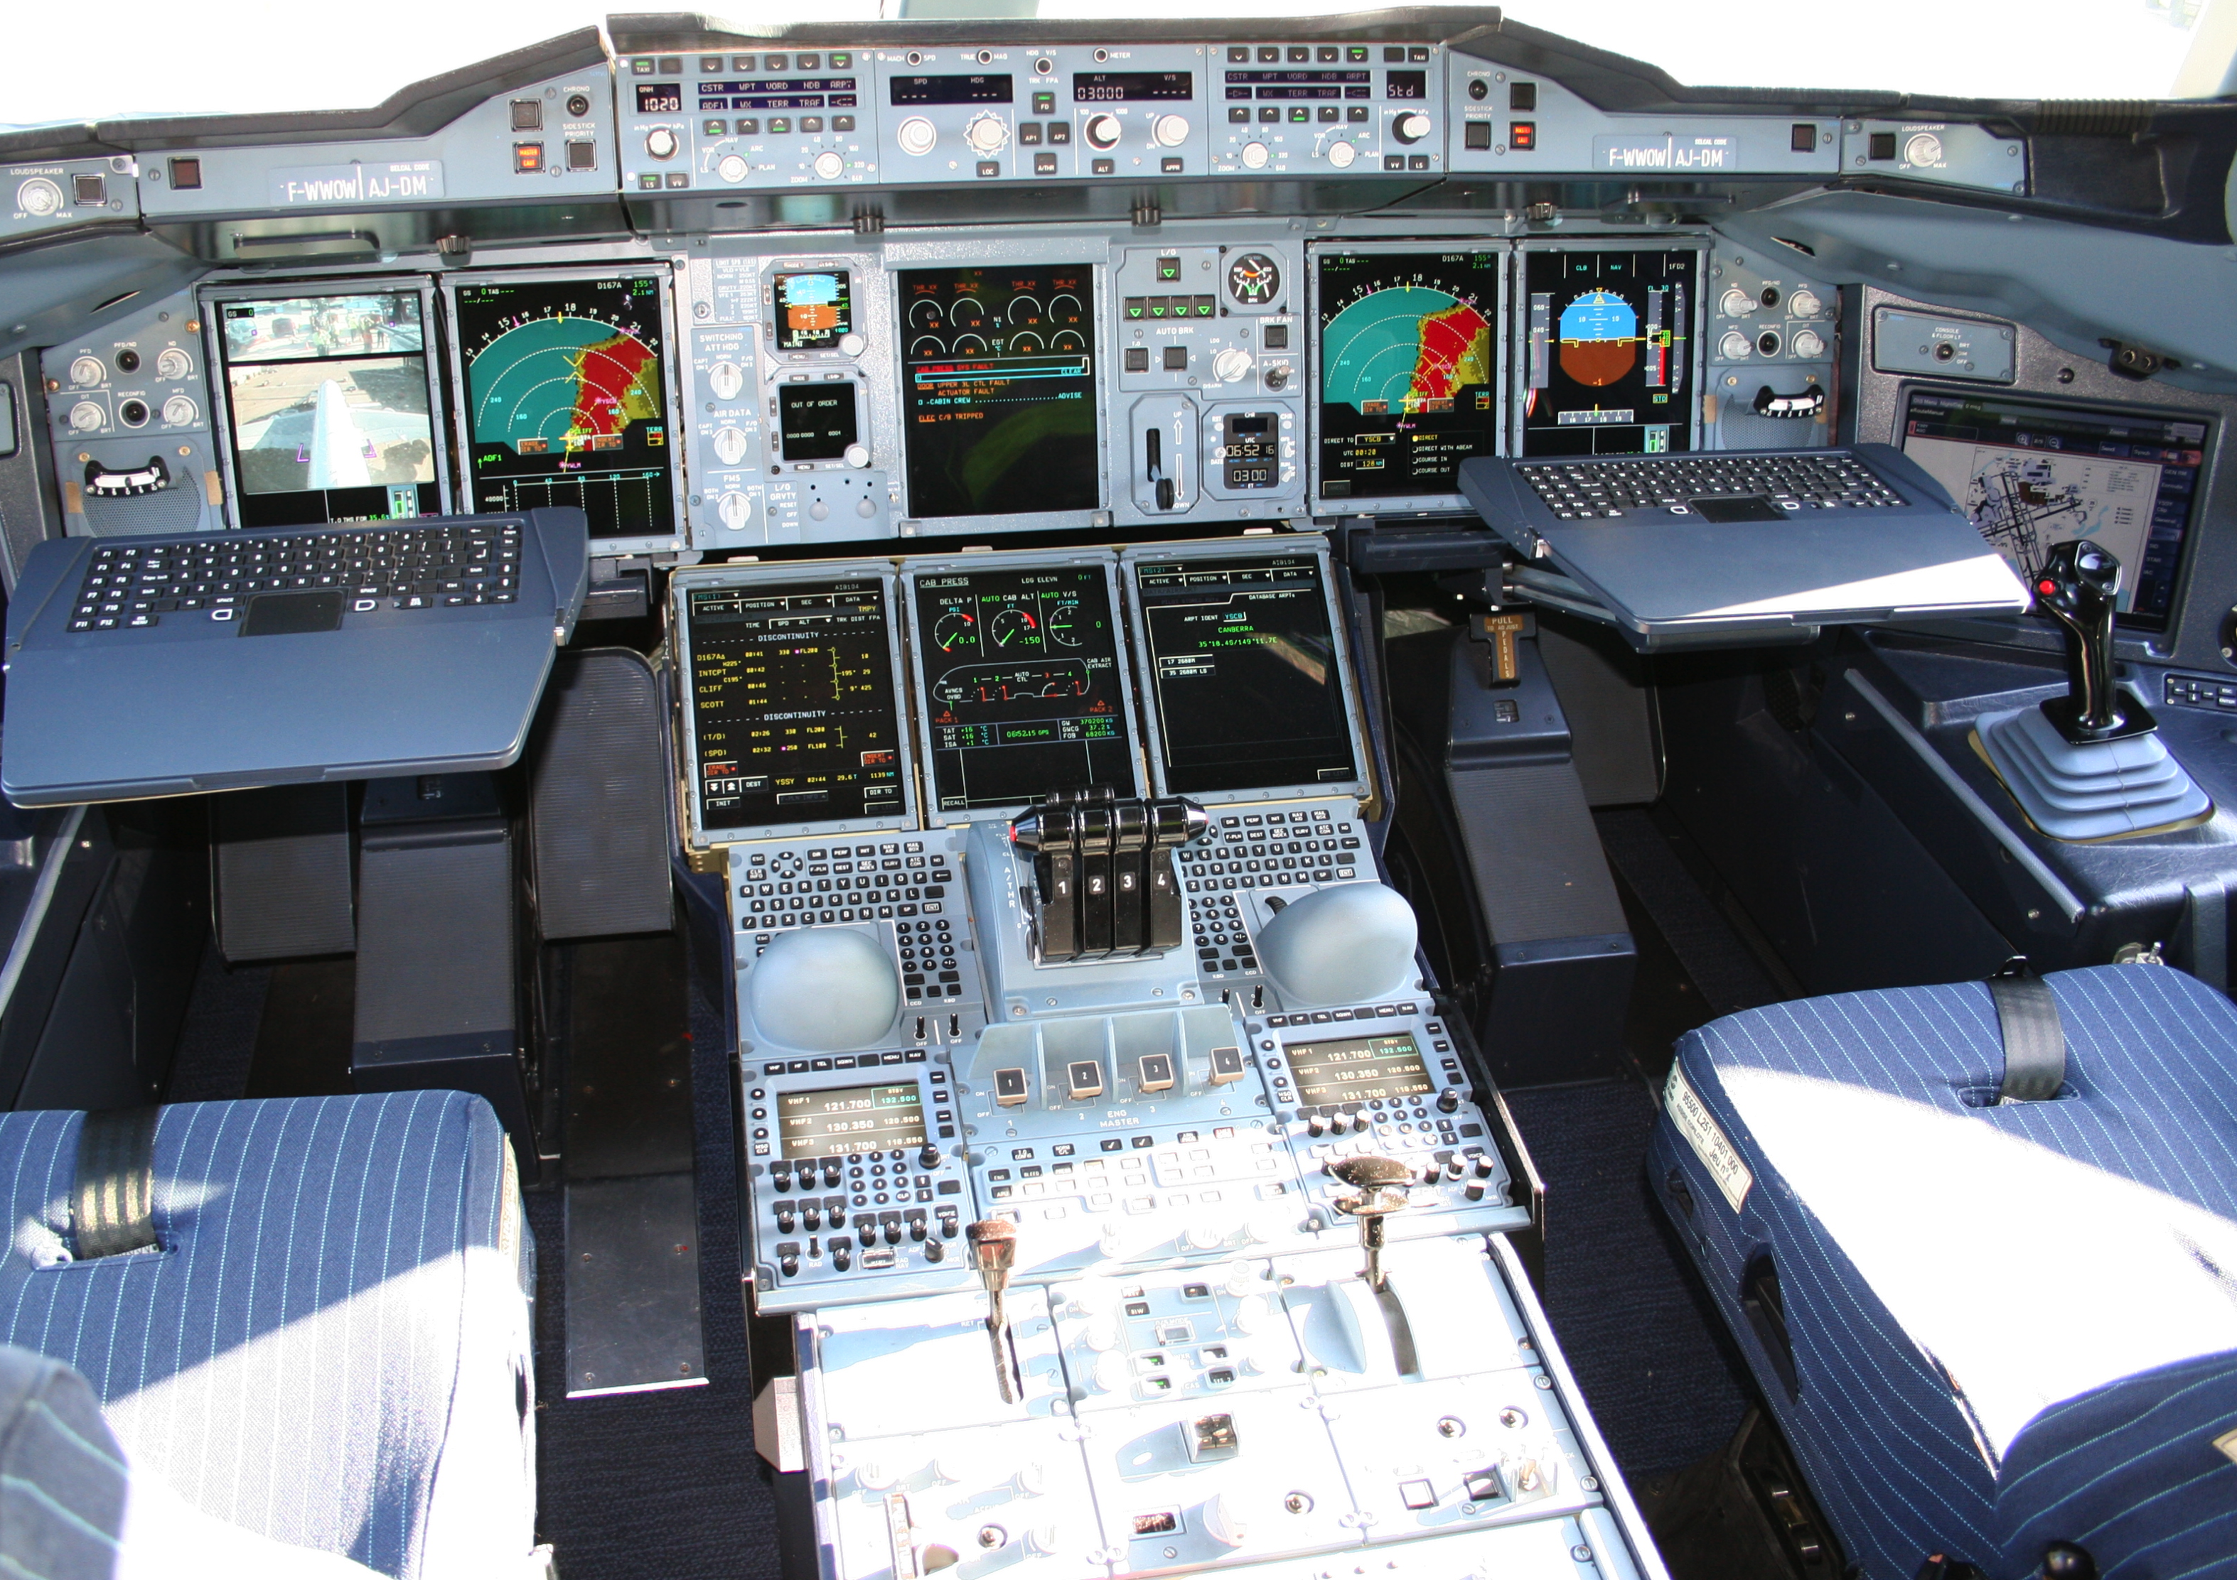









Mechanical
Structure
Airlines
Human-Machine Interaction
Avionics
Multiple
Concerns
Aerodynamics
Environmental
Impact
Propulsion
System
Safety
Regulations
Communications
Authorities
Navigation
Notes:
This piece of complex software integrates different perspectives from these stakeholders
Physics, communications, Pilots -> HCI

Slide 20
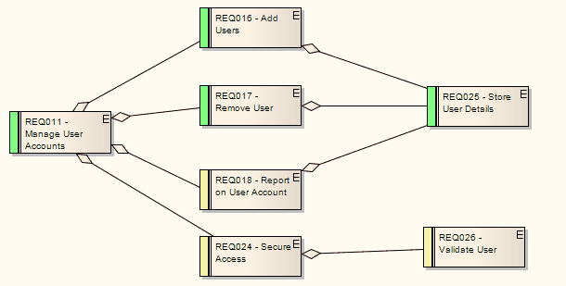
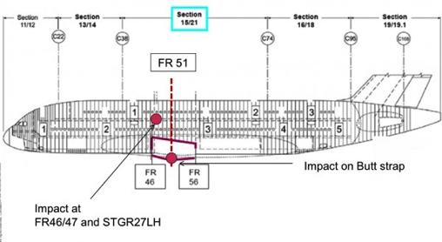
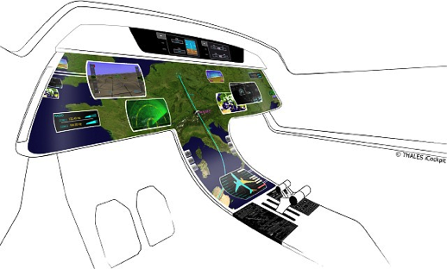
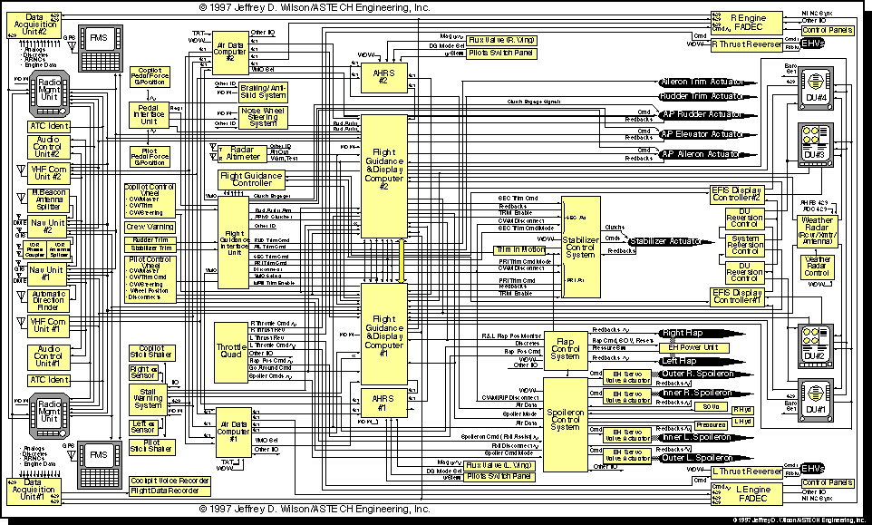
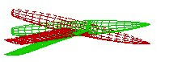
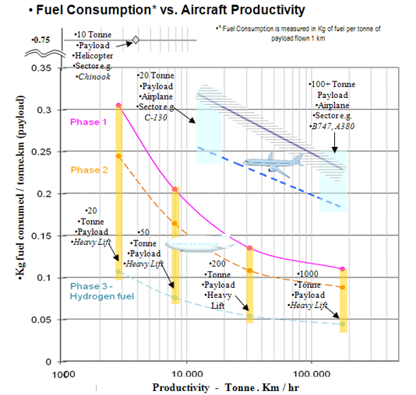
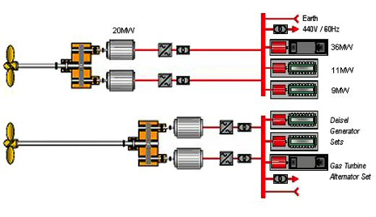
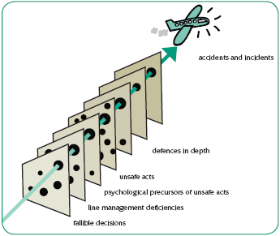
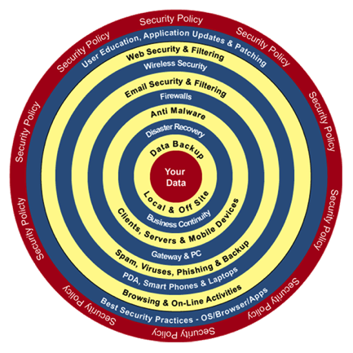
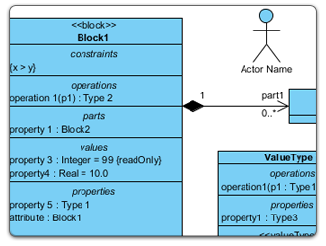
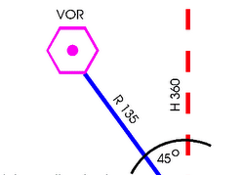
Mechanical
Structure
Airlines
Human-Machine Interaction
Avionics
Heterogeneous Modeling
Aerodynamics
Environmental
Impact
Propulsion
System
Safety
Regulations
Communications
Authorities
Navigation
Notes:
Parler ici du positionnement avec la co-simulation

Slide 21

The GEMOC initiative
An open and international initiative to
foster globalization of DSMLs in open world
impossible a priori unification
require a posteriori globalization
coordinate (between members) and disseminate (for the members)
Organizes
workshop series
Dagstuhl and Bellairs seminars
http://gemoc.org @gemocinitiative

Slide 22

The GEMOC Research Consortium
Technological support for the GEMOC initiative (http://gemoc.org)
An international effort to develop techniques, frameworks, and environments to facilitate the creation, integration, and automated processing of heterogeneous modeling languages, aka. globalization of modeling languages
The community: international, academia/industry
Different projects
The workshop series
The GEMOC studio
a language workbench to design and coordinate executable modeling languages
a modeling workbench with a generic execution framework for simulation, animation, omniscient debugging, concurrency analysis, and coordination.
Sustaining the GEMOC studio as a research platform
To support experimentations of new solutions by academics
To support pilot projects by industry
To foster relationships between academia and industry
To help industrial transfer and innovation
OSS-based Collaborative Model for R&T, Combemale et al., Oct. 3, 2016
- 22

Slide 23


The GEMOC studio
http://eclipse.org/gemoc
http://gemoc.org/studio
Language
Workbench
Modeling
Workbench
Design and compose your executable DSMLs
Edit and debug
your heterogeneous models

Slide 24
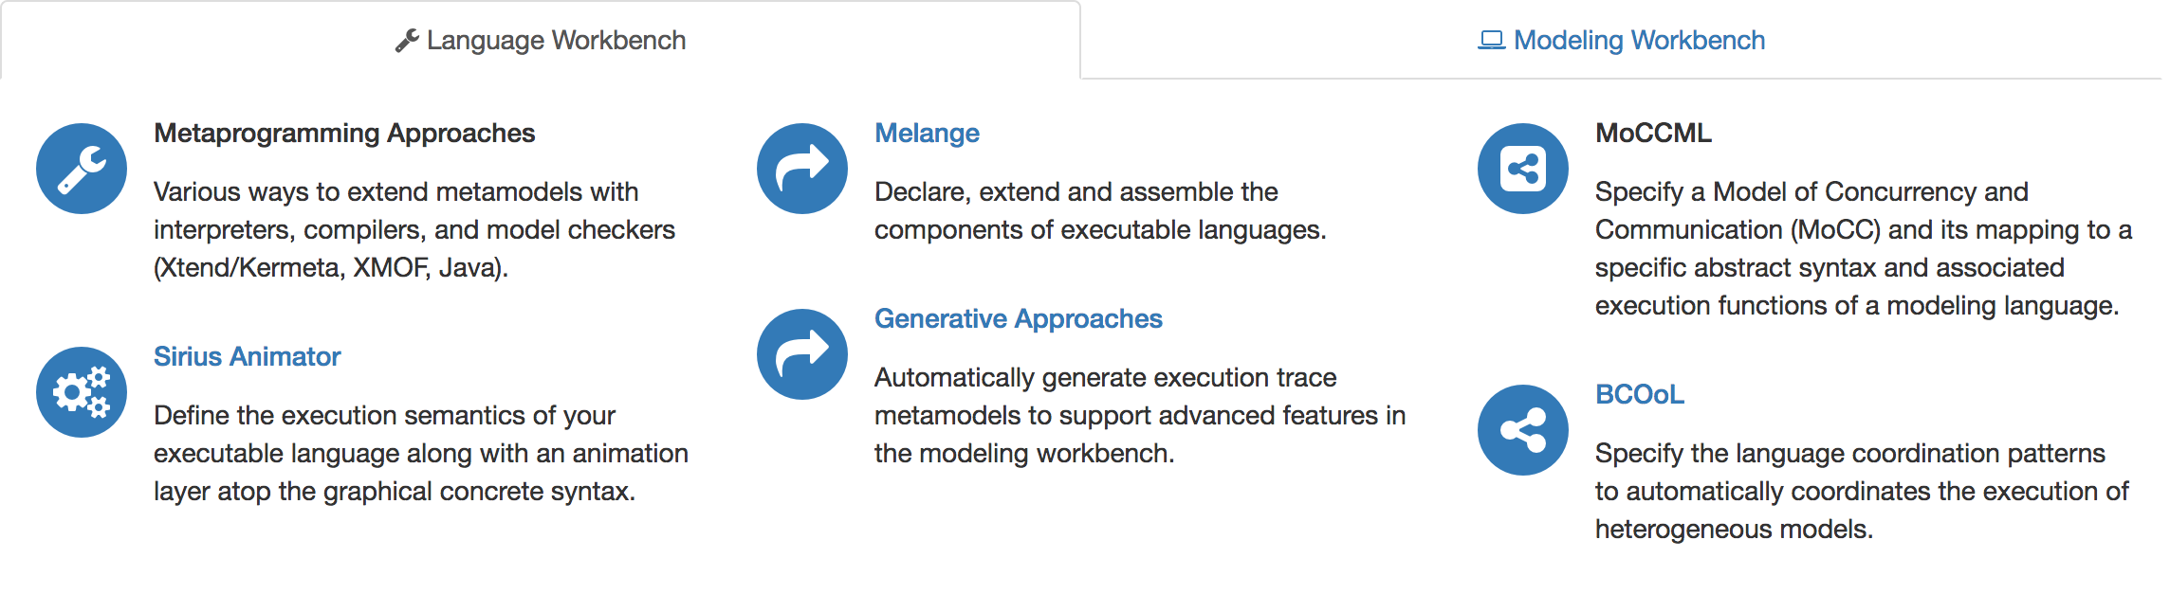

The GEMOC studio: Major Components

Slide 25
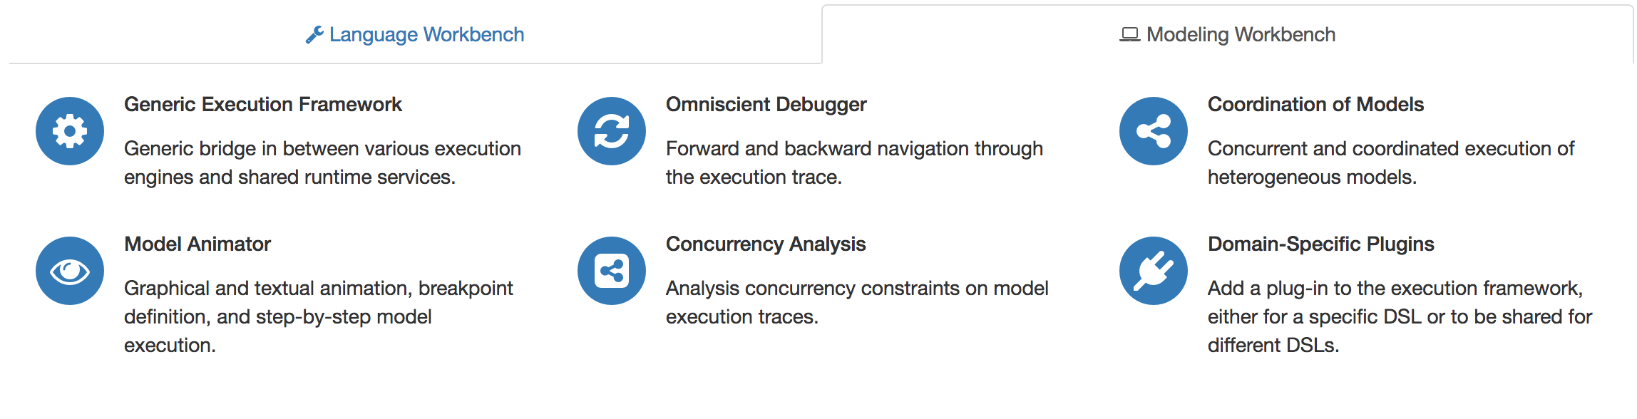
The GEMOC studio: Major Components

Slide 26
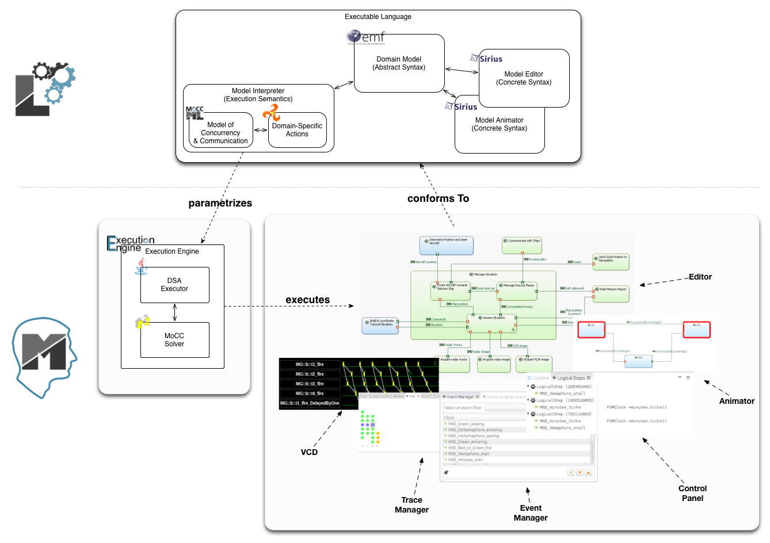
The GEMOC Studio
Benoit Combemale, Julien Deantoni, Olivier Barais, Arnaud Blouin, Erwan Bousse, Cédric Brun, Thomas Degueule and Didier Vojtisek, "A Solution to the TTC'15 Model Execution Case Using the GEMOC Studio," In 8th Transformation Tool Contest (TTC), 2015. Overall Winner
http://gemoc.org/studio/
General Overview (CEA DAM) – B. Combemale – May 29, 2017

Slide 27
The GEMOC Studio
EMF, Xtext, Sirius
Metaprogramming Approaches (Xtend/K3, ALE, XMOF, Java)
Sirius Animator (graphical animation)
Melange (language reuse)
Generative Approaches (execution trace, checking)
MoCCML (concurrency analysis)
BCOoL (behavioral coordination)
Generic Execution Framework
Graphical animation
Breakpoint definition on model element
Multi-dimensional and efficient trace management
Model omniscient debugging facilities (incl., timeline, step backward, stimuli management, etc.)
Concurrency Analysis
Coordination of Models
Domain-Specific Plugins
Benoit Combemale, Julien Deantoni, Olivier Barais, Arnaud Blouin, Erwan Bousse, Cédric Brun, Thomas Degueule and Didier Vojtisek, "A Solution to the TTC'15 Model Execution Case Using the GEMOC Studio," In 8th Transformation Tool Contest (TTC), 2015. Overall Winner
http://gemoc.org/studio
General Overview (CEA DAM) – B. Combemale – May 29, 2017

Slide 28
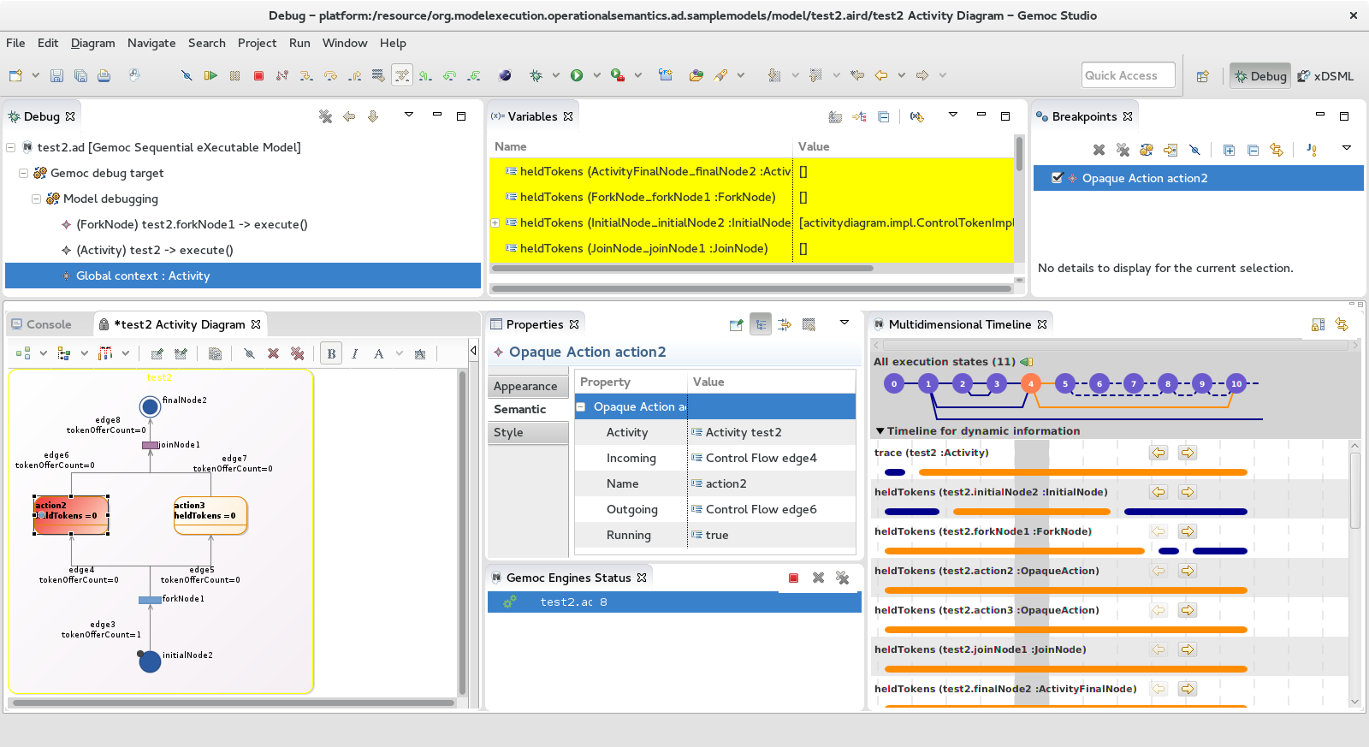
Activity Diagram Debugger
https://github.com/gemoc/activitydiagram
General Overview (CEA DAM) – B. Combemale – May 29, 2017

Slide 29
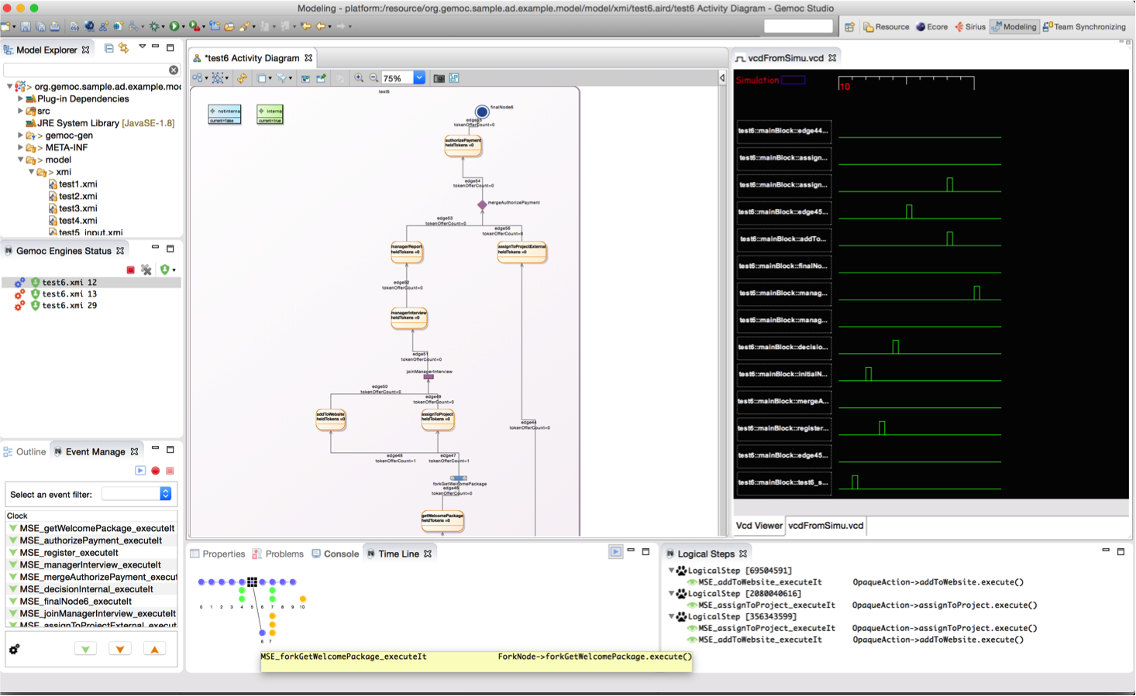
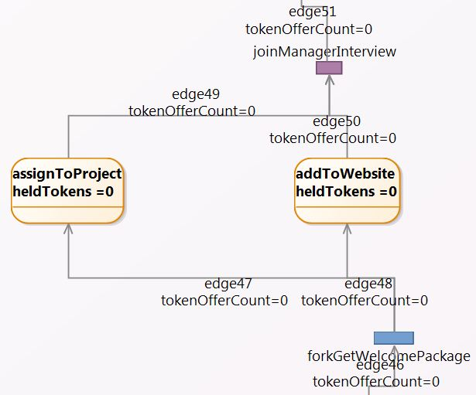
Activity Diagram Debugger
Benoit Combemale, Julien Deantoni, Matias Vara Larsen, Frédéric Mallet, Olivier Barais, Benoit Baudry, Robert France, "Reifying Concurrency for Executable Metamodeling," In Software Language Engineering (SLE), 2013

Slide 30
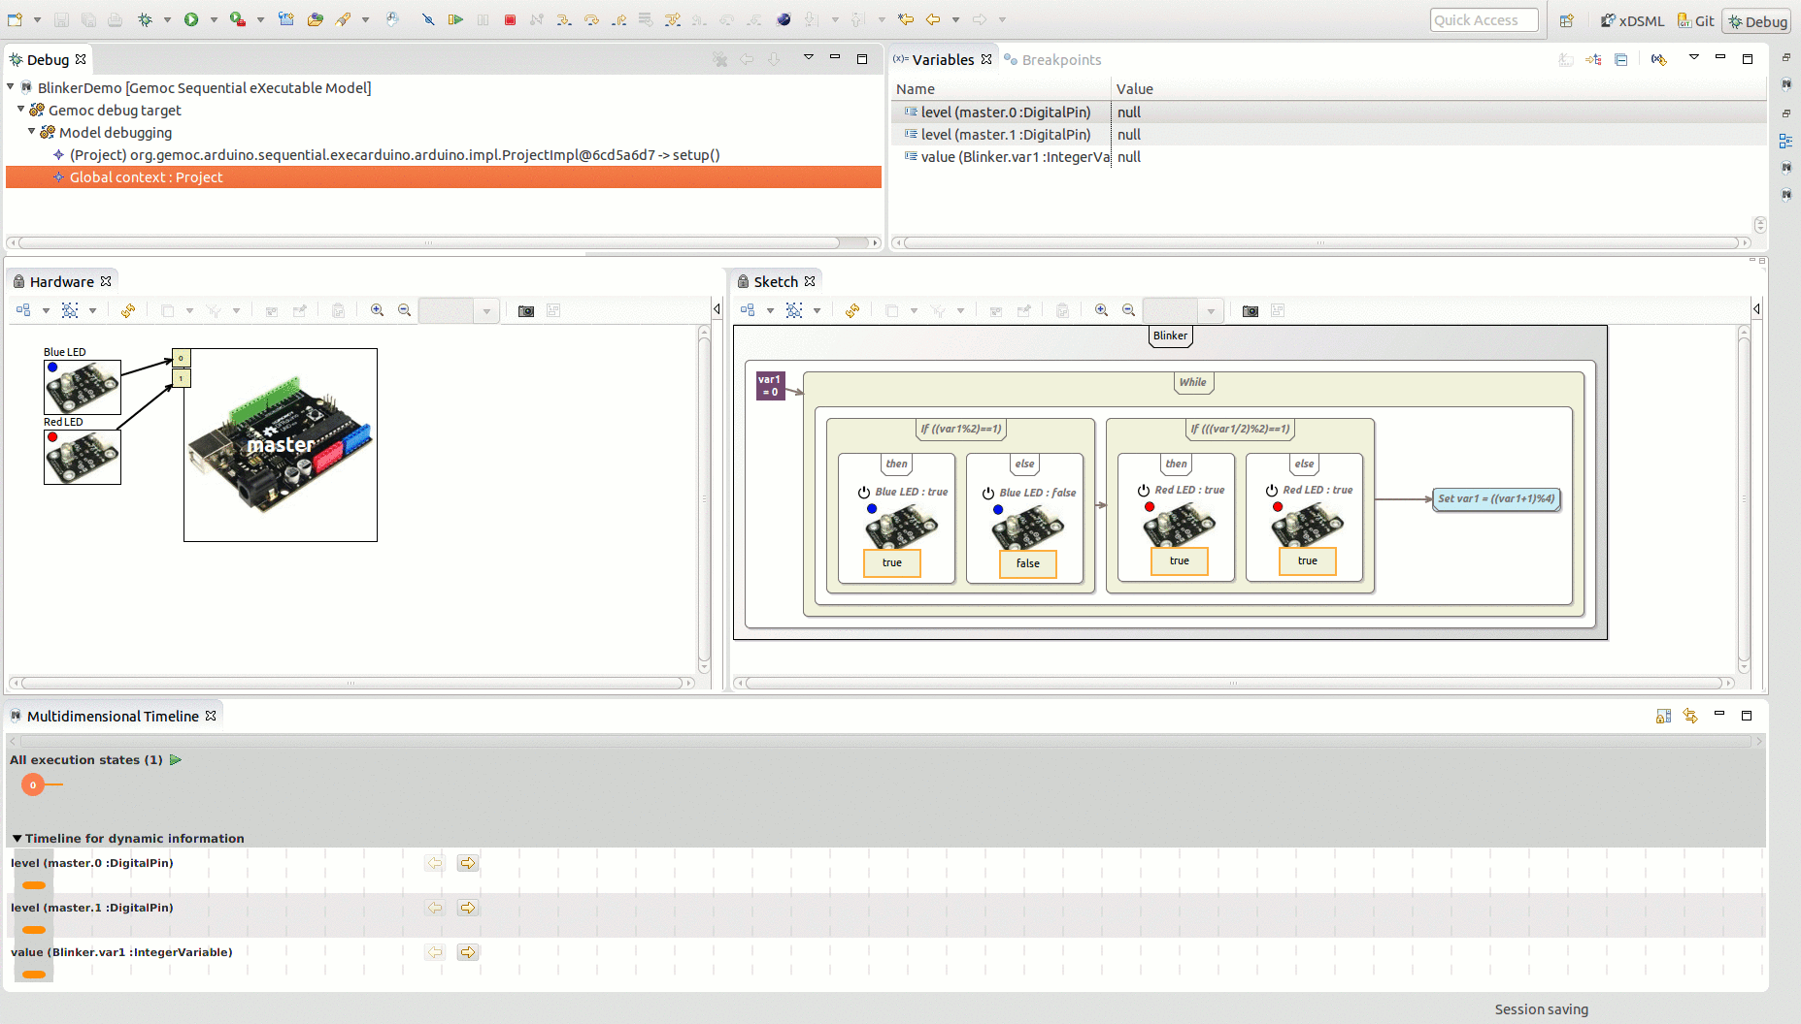
Arduino Designer (& Debugger)
https://github.com/gemoc/arduinomodeling

Slide 31
Transformation Lg Debugger
TETRABox
http://modeltransformation.net/tetrabox/
Wimmer, Bousse et al.
https://github.com/tetrabox/minitl

Slide 32

Behavioral Model Coordination
Matias Ezequiel Vara Larsen, Julien Deantoni, Benoit Combemale, Frédéric Mallet, "A Behavioral Coordination Operator Language (BCOoL)," In MODELS 2015

Slide 33
It’s your turn!

Slide 34
This tutorial
See how EMF+GEMOC technologies help to (semi-automatically) build the tooling for a DSL IDE
Build an executable DSL, and see how GEMOC provides
an execution engine,
a graphical model animator,
an omniscient debugger.
Materials are available from https://github.com/gemoc/ICSA2017Tutorial

Slide 35


Hands on - content
Teaser: FSM Example
Abstract syntax: Ecore, OCL
Graphical concrete syntax: Sirius
Execution semantics: K3/Melange

Slide 36
You will learn how to
Build or customize your own abstractions, or even software languages and development environments, to build complex, domain-specific, software-intensive systems
Apply language formalisms, paradigms and principles
Extend a graphical, executable DSL using state of the art techniques
Manage the industrial complexity of developments and associated toolchains

Slide 37
A few notes on the tutorial
Interweave a total of 90 min introduction to SLE and 90 min hands-on time
Creating a sufficiently interesting, yet full-blown, modeling language including syntax, semantics, and editors in 90 minutes is challenging to impossible
To introduce the quintessential aspects of language engineering to you we will ask you to clear your workspace and download different stages of the languages under development. Please look out for the following symbol: on the tutorial website https://github.com/gemoc/ICSA2017Tutorial

Slide 38
Running the FSM Example
STEP 2.1

Slide 40
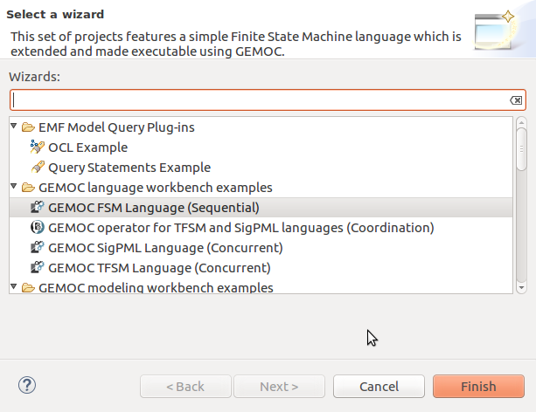
Load the FSM language
(see https://github.com/gemoc/ICSA2017Tutorial)

Slide 41
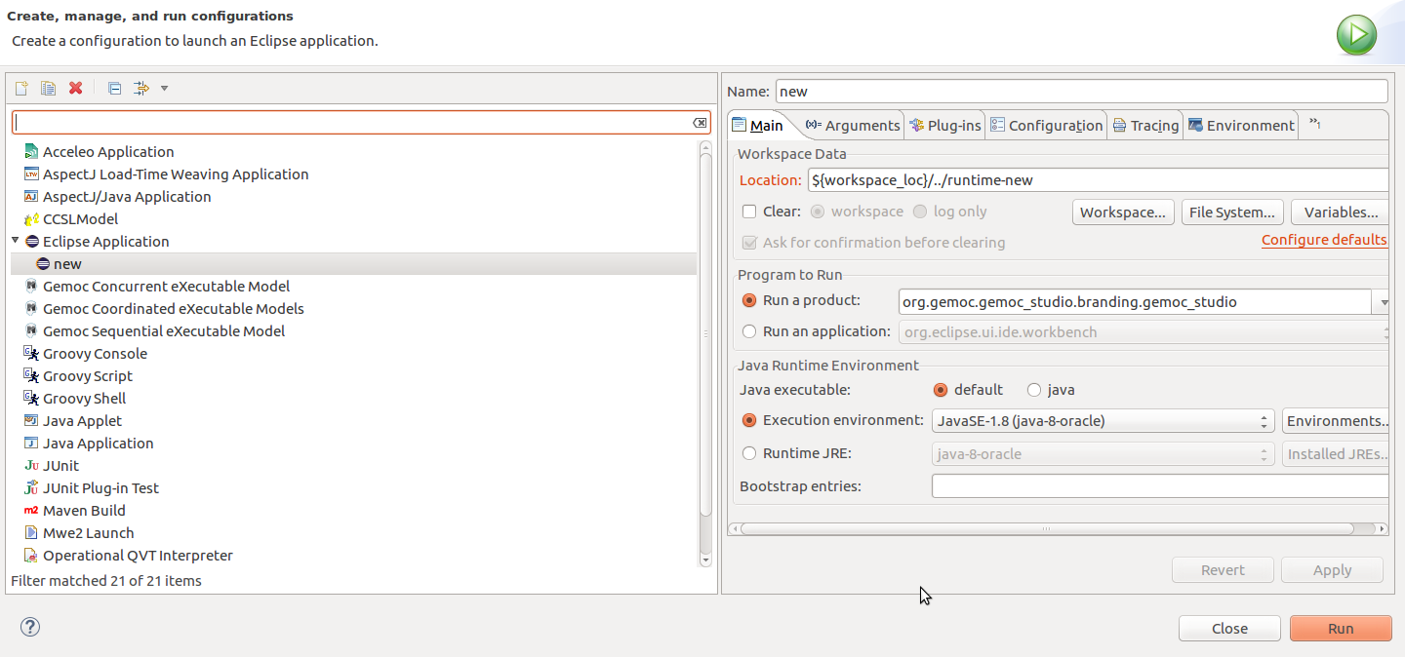
Start the modeling workbench
(see https://github.com/gemoc/ICSA2017Tutorial)

Slide 42
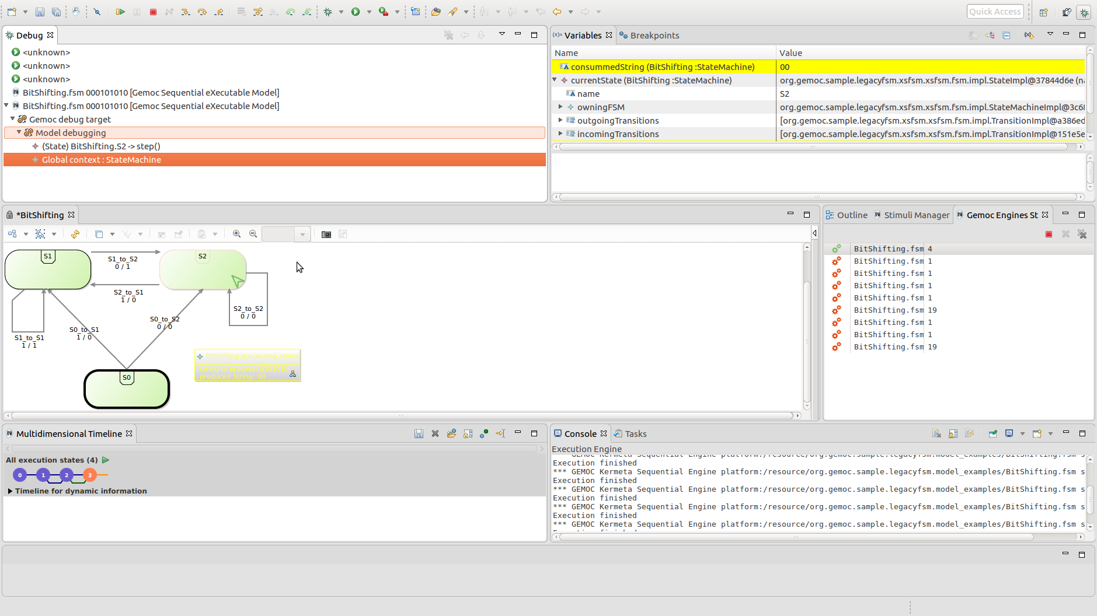
Examine and run your models
stack trace
variable values
graphical model representation
execution trace
(see https://github.com/gemoc/ICSA2017Tutorial)

Slide 43
ABSTRACT SYNTAX EXTENSION
STEP 2.2

Slide 44
Abstract syntax defines your domain
We use Ecore to define the concepts and relations of the domain of FSMs
Alternatives are MOF, grammars, …
Editors
(textual, graphical, …)
Checkers
(static & dynamics)
Documentation generators
Compilers
Test generators
Translators
Simulators
Code generators
Analyzers
Refactoring
Etc.

Slide 45
Ecore/EMF
EMF serves as the foundation: It provides the Ecore meta-metamodel (basically a Class diagram ), and frameworks and tools around it :
EMF provides almost for free (among other features)
Serialization (XMI)
Tree editor
either reflective, or generated with possibility to customize
Edition support (outline, notification API for other editors, …)
Java manipulation API
EMF compatible projects use this as a base to propose extended services

Slide 46
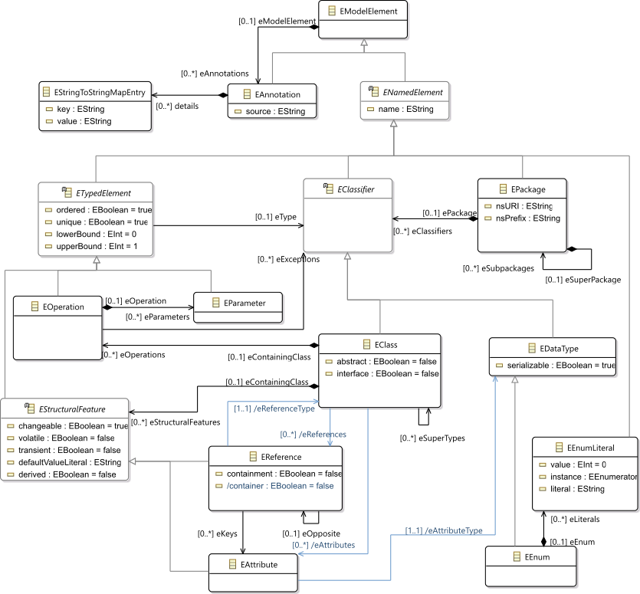
Ecore most used concepts
(removed most helper derived features, operations and generic support)

Slide 47
OCL invariants
Class diagram structure implies design choices
Invariants (e.g., in OCL) can complement it in order to enforce the consistency of models
Editors
(textual, graphical, …)
Checkers
(static & dynamics)
Documentation generators
Compilers
Test generators
Translators
Simulators
Code generators
Analyzers
Refactoring
Etc.

Slide 49
Extend FSM abstract syntax
Add concepts for variables, guards, and actions to your FSM language
Use the graphical metamodel editor
Add an OCL invariant to your language

Slide 50
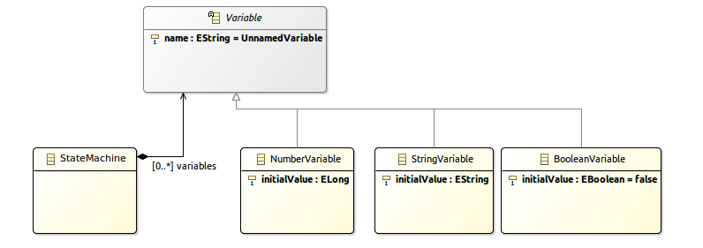
Add concept Variable
(see https://github.com/gemoc/ICSA2017Tutorial)

Slide 51

Add concept Guard
(see https://github.com/gemoc/ICSA2017Tutorial)

Slide 52

Add concept Action
(see https://github.com/gemoc/ICSA2017Tutorial)

Slide 53

Add OCL invariant
Use the OCLInEcore editor
Add invariant: states cannot have two outgoing transitions without a guard
Syntax example: check name uniqueness
invariant uniqueStateNames:
self.states->forAll(s1, s2| s1 <> s2 implies s1.name <> s2.name);
(see https://github.com/gemoc/ICSA2017Tutorial)

Slide 54
DYNAMIC SEMANTICS EXTENSION
STEP 2.3

Slide 55
Adding behavior to models
Two main ways to add behavior
Operational, i.e., an interpreter
Translational, i.e., a compiler
Editors
(textual, graphical, …)
Checkers
(static & dynamics)
Documentation generators
Compilers
Test generators
Translators
Interpreters
Code generators
Analyzers
Refactoring
etc.

Slide 56
Adding operational behavior to models
Usually abstract syntax traversal navigating the model
Adding operations to the Ecore metamodel enables adding behavior to the language
but breaks separation of concerns and language reuse
Traditional approaches: visitor design pattern
However, it doesn't scale to
runtime performance
multiple metamodels
language composition
modular evolution with new functionality
Notes:
Expression problem of OO

Slide 57
Meet Kermeta and Melange
Kermeta
Advanced visitor pattern to add aspect oriented behavior
see classes as if they where "reopened" and extended
Supports adding operations, attributes, associations, inheritance
@Main denotes entry points
@Step execution functions represented as visible steps
Melange
Language assembly: compose static metamodel (Ecore) with dynamic aspects (Kermeta) to generate a language implementation
Language composition: inheritance, merge, slice…

Slide 58


Combining language parts with Melange
xx
Adds operation and attributes
may add new concepts too by using multiple Ecore files
Melange generates the new resulting implementation

Slide 60
Extend FSM dynamic semantics
The FSM aspects are defined in the file tfsmAspects.xtend of project org.gemoc.sample.legacyfsm.fsm.k3dsa
Investigate these (watch for @Main and @Step)
Two methods are not implemented (marked ”TODO”): please implement these
(see https://github.com/gemoc/ICSA2017Tutorial)

Slide 61

Edit Kermeta aspects
(see https://github.com/gemoc/ICSA2017Tutorial)

Slide 62

Generate executable language
(see https://github.com/gemoc/ICSA2017Tutorial)

Slide 63

Inspect woven-in operations
new operations
Check metamodel of generated project org.gemoc.sample.legacyfsm.xsfsm
(see https://github.com/gemoc/ICSA2017Tutorial)

Slide 64


Create and run extended model
(see https://github.com/gemoc/ICSA2017Tutorial)

Slide 65
Concrete syntax extension
STEP 2.4

Slide 66
Graphical concrete syntax with Sirius
Another plugin for the eclipse infrastructure
Enables creating graphical editors for ECore metamodels
Editors
(textual, graphical, …)
Checkers
(static & dynamics)
Documentation generators
Compilers
Test generators
Translators
Simulators
Code generators
Analyzers
Refactoring
etc.

Slide 67




Views for language engineers and modelers
Language engineers
Modelers
Specification environment
Runtime environment

Slide 68

Examples of viewpoints

Slide 70
Extend FSM concrete syntax
Define the representation of guards and actions instances for the static perspective.
Define the rendering of variables for the run-time representation.
(see https://github.com/gemoc/ICSA2017Tutorial)

Slide 71

Final representation
stack trace
variable values
textual representation of transition guards and actions
dynamic representation of variable values
tracing
(see https://github.com/gemoc/ICSA2017Tutorial)

Slide 72

Mind the different perspectives
(see https://github.com/gemoc/ICSA2017Tutorial)

Slide 73
WRAP-UP and Discussion
PART 3

Slide 74
Reifying concurrency in executable DSLs
Concurrency remains implicit and ad-hoc in language design and implementation:
Design: implicitly inherited from the meta-language used
Implementation: mostly embedded in the underlying execution environment
The lack of an explicit concurrency specification in language design prevents:
leveraging the concurrency concern of a particular domain or platform
a complete understanding of the behavioral semantics
effective concurrency-aware analysis techniques
effective techniques for producing semantic variants
analysis of the deployment on parallel architectures

Slide 75
Activity diagram debugger
https://github.com/gemoc/activitydiagram

Slide 76


Coping with semantic variation points
Florent Latombe, Xavier Crégut, Julien Deantoni, Marc Pantel, Benoit Combemale, "Coping with Semantic Variation Points in Domain-Specific Modeling Languages", In EXE@MoDELS 2015.

Slide 77

Summary of the sequential approach

Slide 78

Concurrency management

Slide 79

Model coordination
Once the event notion has been reified, it is then possible to reason about it.
i.e., un several models at the same time and coordinate them
In GEMOC we have, the Behavioral Coordination Operator Language

Slide 80




generates
generates
generates
generates
generates
generates
Language 2
Language 2
Language 2
Language 2
Language 2
Language 2
Conforms to
Conforms to
Conforms to
Conforms to
Conforms to
Conforms to
System
Designer
System
Designer
System
Designer
System
Designer
System
Designer
System
Designer
defines
defines
defines
defines
defines
defines
Model 1
Model 1
Model 1
Model 1
Model 1
Model 1
Coordination
/
Communication
Coordination
/
Communication
Coordination
/
Communication
Coordination
/
Communication
Coordination
/
Communication
Model 2
Coordination
/
Communication
Model 2
Model 2
Model 2
Model 2
Model 2
Model A
Model A
Model A
Model A
Model A
Model 3
Model A
Model 3
Model 3
Model 3
Model 3
Model 3
Model B
Model B
Model B
Model B
Model B
Model B
Model B
Model B
Model B
Model B
Model B
Model B

Slide 81
Behavioral Model Coordination
Matias Ezequiel Vara Larsen, Julien Deantoni, Benoit Combemale, Frédéric Mallet, "A Behavioral Coordination Operator Language (BCOoL)," In MODELS 2015

Slide 82
Take-away messages
DSLs are important (as intuited for a long time – it will become more and more apparent)
DSL technology is here and ready to use
Over 30 language workbenches in the wild (cf. http://2016.splashcon.org/track/lwc2016)
Software language engineering is maturing to support MDE

Slide 83
Wrap-up and discussion
Today you have
executed models of the FSM language
extended its metamodel with new variables, guards, and transitions using Ecore
restricted it with OCL well-formedness rules using OclInEcore
augmented its dynamic semantics to consider the new modeling elements using Kermeta
extended its concrete graphical syntax and editor using Sirius
combined two modeling languages to produce executable architecture models using Melange
Tomorrow you would
Use other meta programming approaches (ALE, XMOF)
Bring textual concrete syntax to editors and animators (Xtext)
Add concurrency constraints into the behavioral semantics of domain specific concepts (MOCCML)
Coordinate heterogeneous executable modeling languages to support concurrent model execution (BCOoL)

Slide 84
Montiarc ADL
DIGRESSION

Slide 85
MontiArc¹ in a nutshell
Extensible component & connector ADL
Based on Focus semantics for distributed systems²
semantics domain are stream-processing functions
Minimal design featuring
component types and instance, component inheritance
atomic and hierarchically composed components
component interfaces of typed, directed ports
1st version: textual with MontiCore³ language workbench
Haber, A. (2016). MontiArc - Architectural Modeling and Simulation of Interactive Distributed Systems
Ringert, J. O., & Rumpe, B. (2011). A Little Synopsis on Streams, Stream Processing Functions, and State-Based Stream Processing.
Krahn, H., Rumpe, B., Völkel, S. (2008). MontiCore: Modular Development of Textual Domain Specific Languages

Slide 86
MontiArc extensions
Δ-MontiArc¹ is a DSL for expressing deltas on MontiArc component definitions, for bottom-up product lining.
MontiArcHV² allows specifying component variability fully integrated within the component hierarchy located at variation points in component definitions.
clArc³ is a variant for modeling self-replicating cloud services.
MontiArcAutomaton⁴ extends MontiArc with behavior language embedding and robotics-related modeling elements.
Haber, A., Rendel, H., Rumpe, B., Schaefer, I. (2012). Evolving Delta-oriented Software Product Line Architectures.
Haber, A., Rendel, H., Rumpe, B., Schaefer, I., van der Linden, F. (2012). Hierarchical Variability Modeling for Software Architectures.
Navarro Perez, A., Rumpe, B. (2013). Modeling Cloud Architectures as Interactive Systems.
Wortmann, A. (2016). An Extensible Component & Connector Architecture Description Infrastructure for Multi-Platform Modeling.

Slide 87

MontiArc example
CD
Garbages
Pose
ArmPose
composed
component
generic data type parameter
CD data types
subcomponent injection
CleaningRobot
MA
Garbage Detector
Garbages
ActionController<T>
ctrl
Pose
Navigation nav
FSM
Arm(Planner p)
Planner p
ArmPose
ArmCtrl
Container Checker
Int
Gripper
gr
s
T
cs
Bool
unidirectional connector between ports s and cs of type Boolean
atomic component with embedded port automaton model
subcomponent gr of type Gripper

Slide 88
XMontiArc¹
MontiArc variant for operational execution
Built on top of GEMOC Studio
Ecore metamodel
OCL static semantics
Kermeta dynamic semantics
Sirius graphical representation
Uses fixed data types (boolean, number, string)
Does not support parametrization, generics, or injection (yet)
Includes FSM language for component behavior modeling
https://github.com/awortmann/xmontiarc

Slide 89
XMontiArc Example
composed
component
CleaningRobot
XMA
Garbage Detector
Number
ActionController ctrl
Number
Navigation nav
Number
Number
FSM
Arm
Planner p
Number
ArmCtrl
Number
Container Checker
Number
Gripper
gr
Boolean
Boolean
s
cs
unidirectional connector between ports s and cs of type Boolean
atomic component with embedded port automaton model
subcomponent gr of type Gripper

Slide 90
XMontiArc Example
composed
component
CleaningRobot
XMA
Garbage Detector
Number
ActionController ctrl
Number
Navigation nav
Number
Number
FSM
Arm
Planner p
Number
ArmCtrl
Number
Container Checker
Number
Gripper
gr
Boolean
Boolean
s
cs
unidirectional connector between ports s and cs of type Boolean
atomic component with embedded port automaton model
subcomponent gr of type Gripper
Graphical representation of intermediate connectors
Embedding of FSM for component behavior

Slide 91
MODEL EXECUTION
STEP 2.1

Slide 92
Eclipse as a platform
Integrated development platform with base workspace and an extensible plug-in system
Contribute to existing IDE
Open structure with third party contributions
Update site, market place, …
Or create your own application
Rich Client Platform (RCP) for general purpose applications
Don’t be afraid of the number of workspace projects
Most of them are due to splitting the java packages for easier deployment and dependency management.

Slide 93
Modeling workbench vs. language workbench
We use eclipse as a language workbench in which we define the constituents of and services for languages in form of eclipse plugins.
From this we start another eclipse instance – the modeling workbench.
Into this, we deploy the tools and services to create models conforming to the language(s) defined in the language workbench.

